Slide 1


Slide 2
Team
Tiffany Ko
Electrical Engineering BSE ’09/ Bioengineering MS ‘12
Bioengineering PhD Candidate/CHOP Researcher
Kobie Mensah-Brown
Bioengineering BSE ‘15
CHOP Research Coordinator
Emily Sewell
Neuroscience BS ‘15
Penn Bioengineering Research Specialist

Slide 3
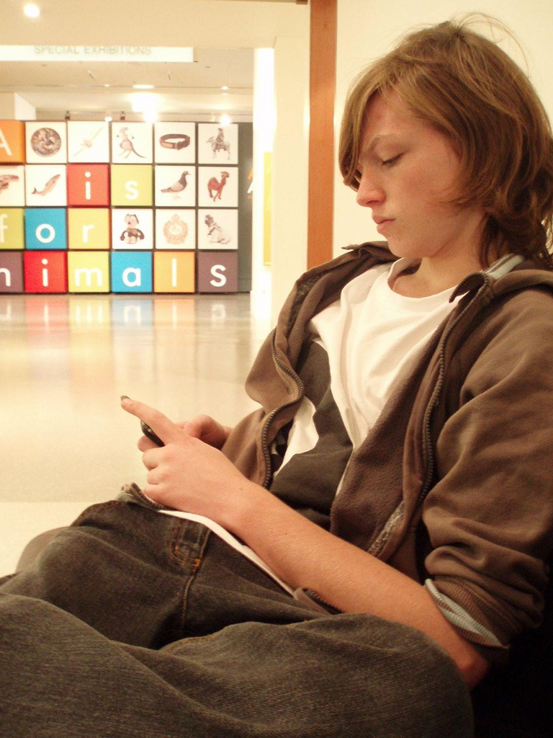
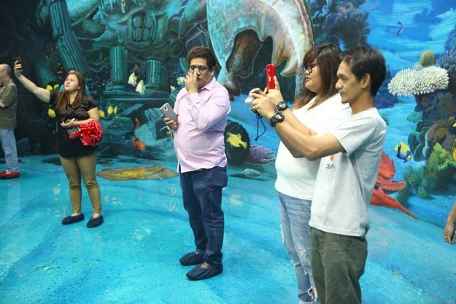
What is Needed
Transform the visitors experience
Connect and Educate the visitors to the artwork on view
Visitor Engagement

Slide 4
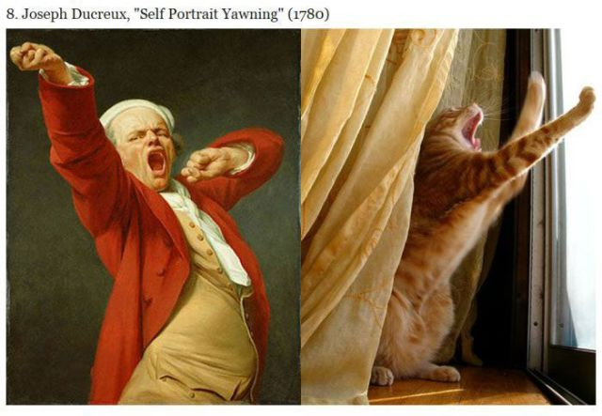
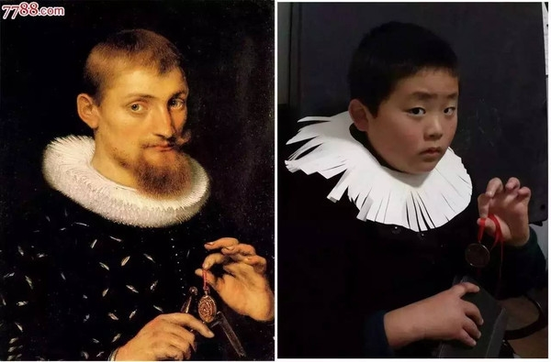
Why Art Play for visitor engagement?
You + Art @ Play
Investigate the museum’s collection of portraits through an interactive experience

Slide 5

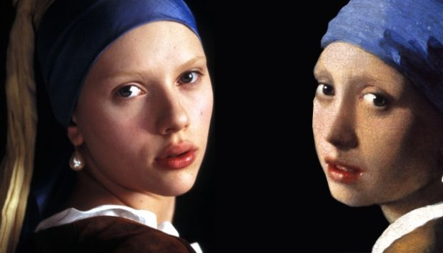
Mission
Browsers to Regulars
Galvanize visitor interest
Create a social, personal environment
Propel an excitement and a better understanding of the collection
Connect to the style and themes of the artwork
Bring the Museum’s collection to life!

Slide 6

Deep Learning Neural Networks

Slide 7
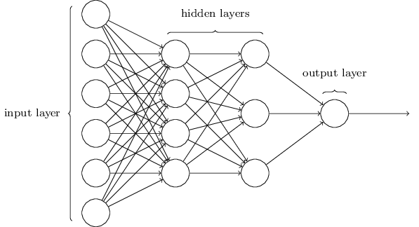

Slide 8
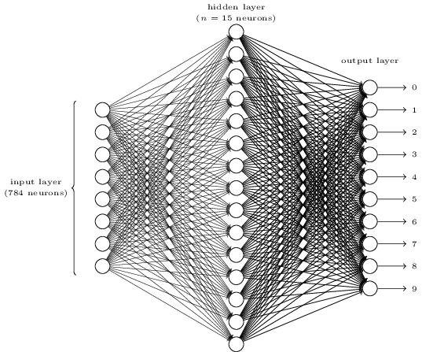

Slide 9
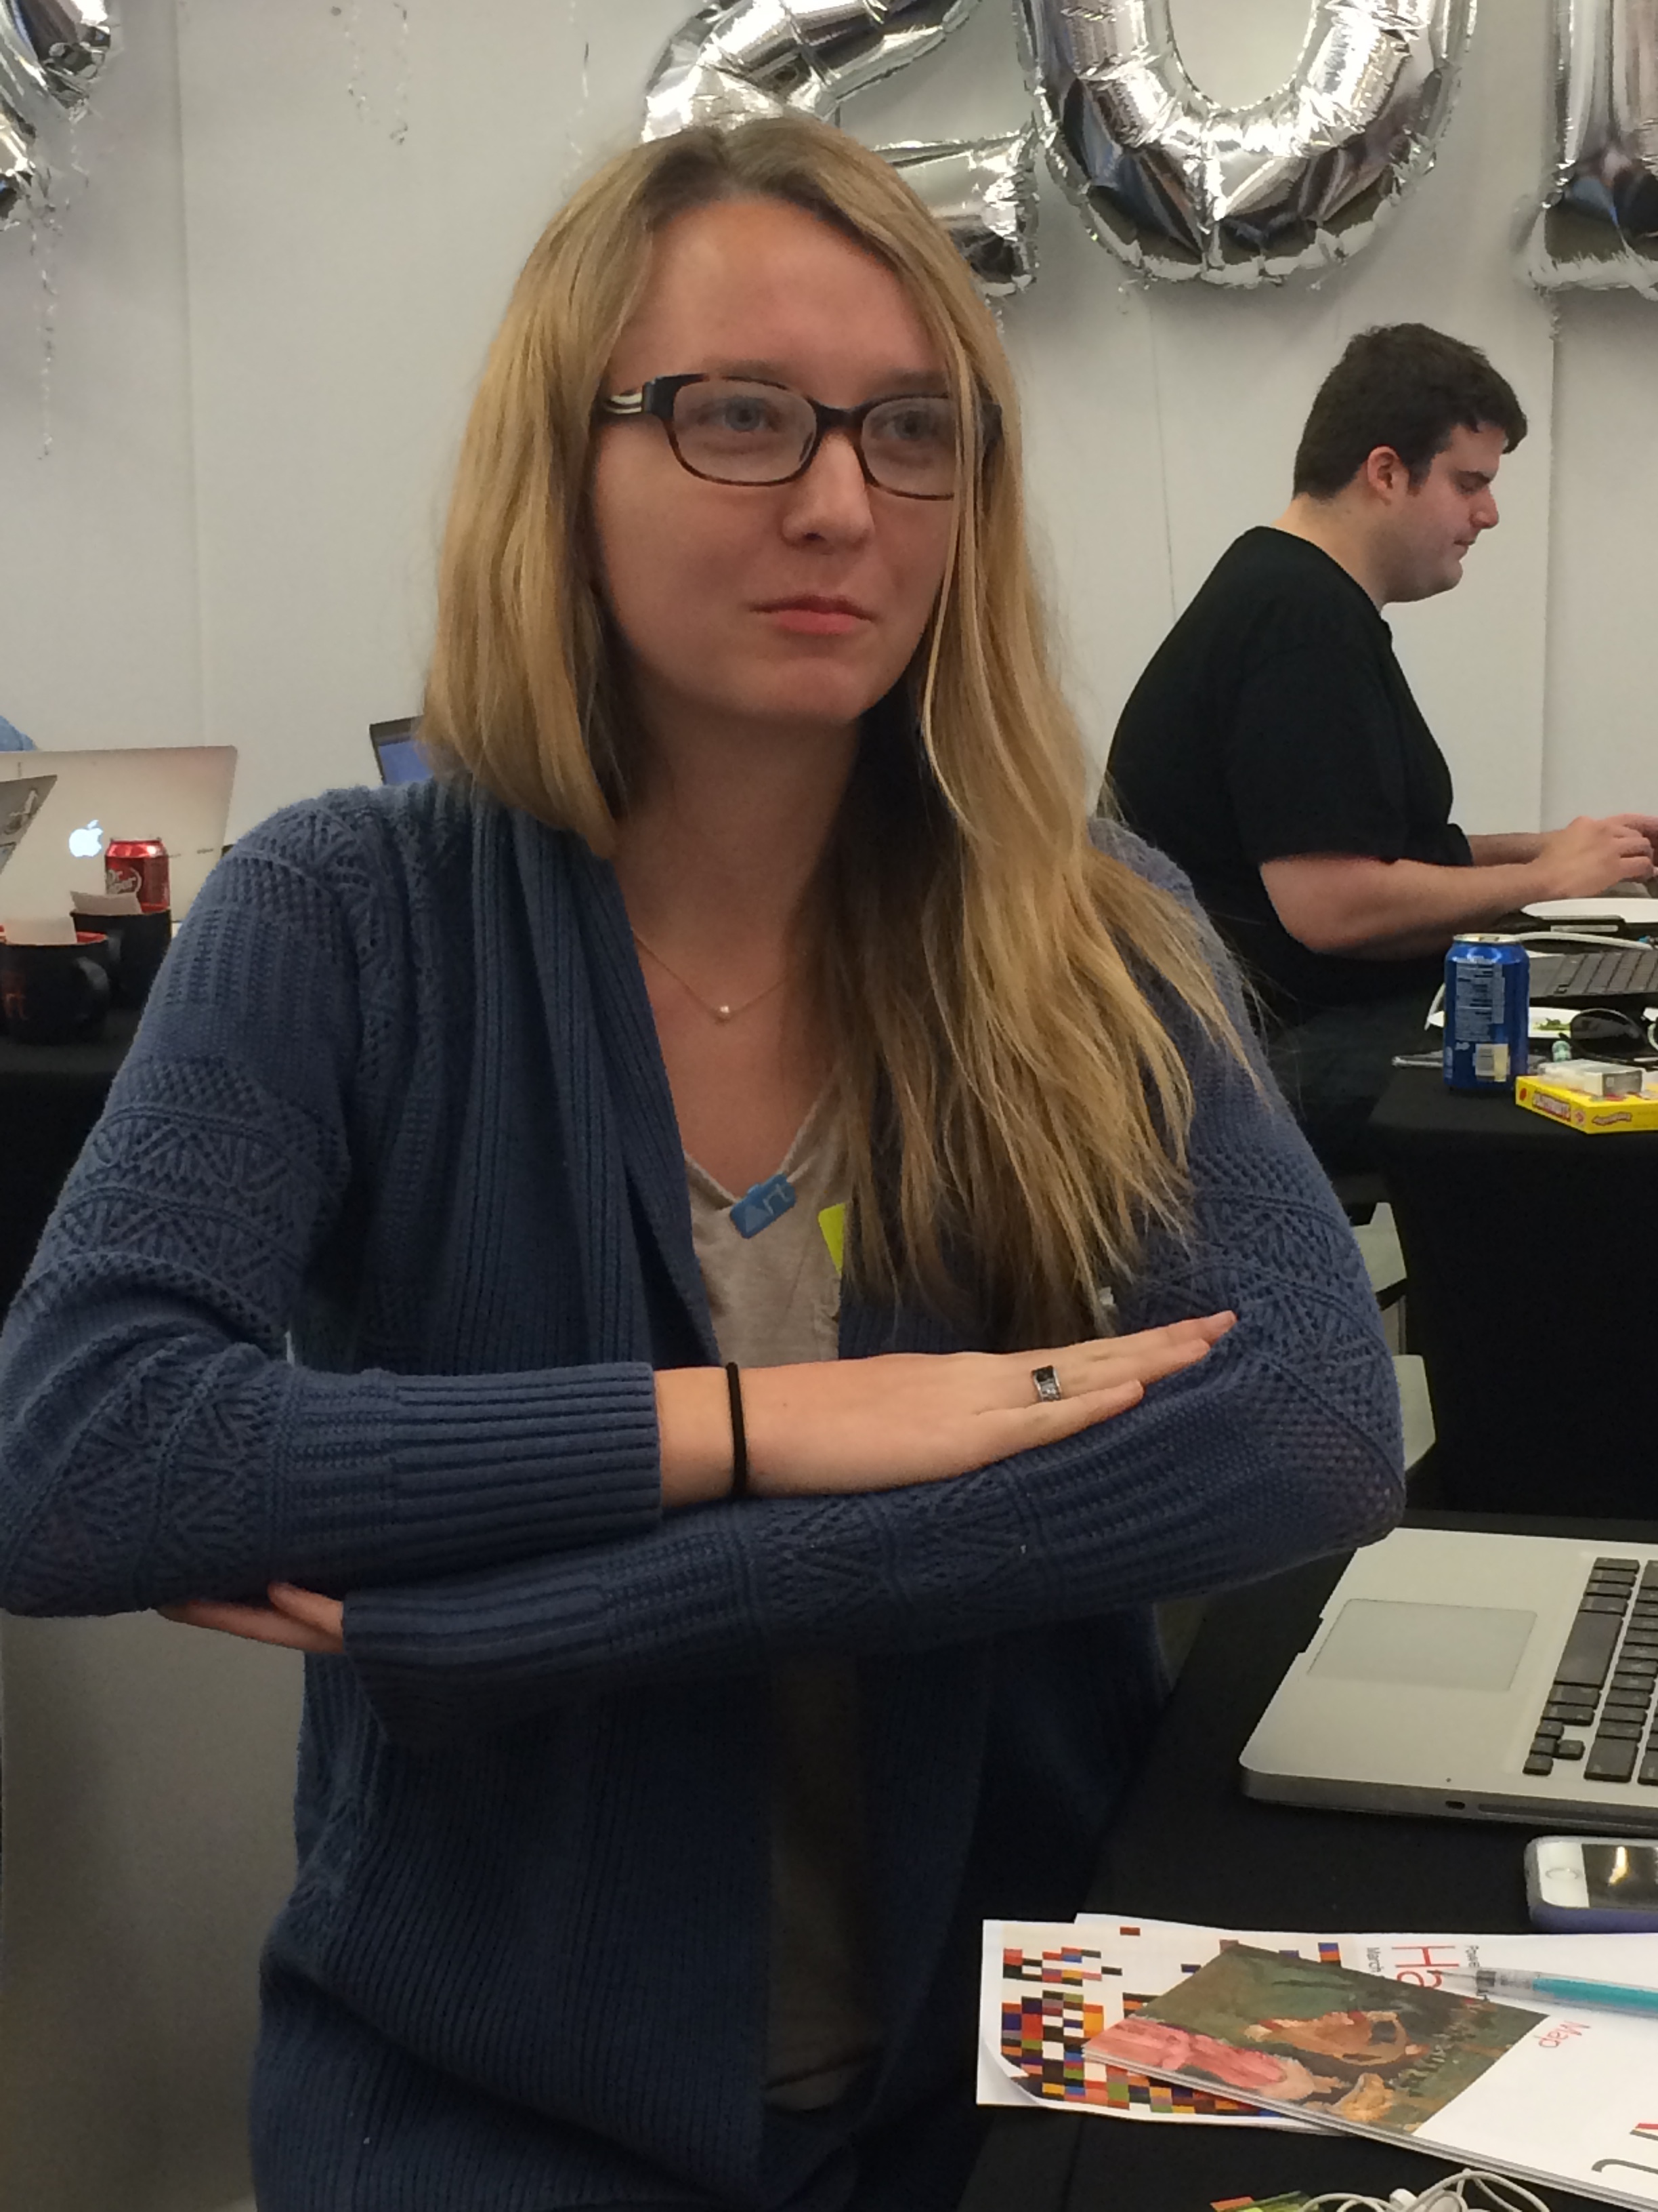
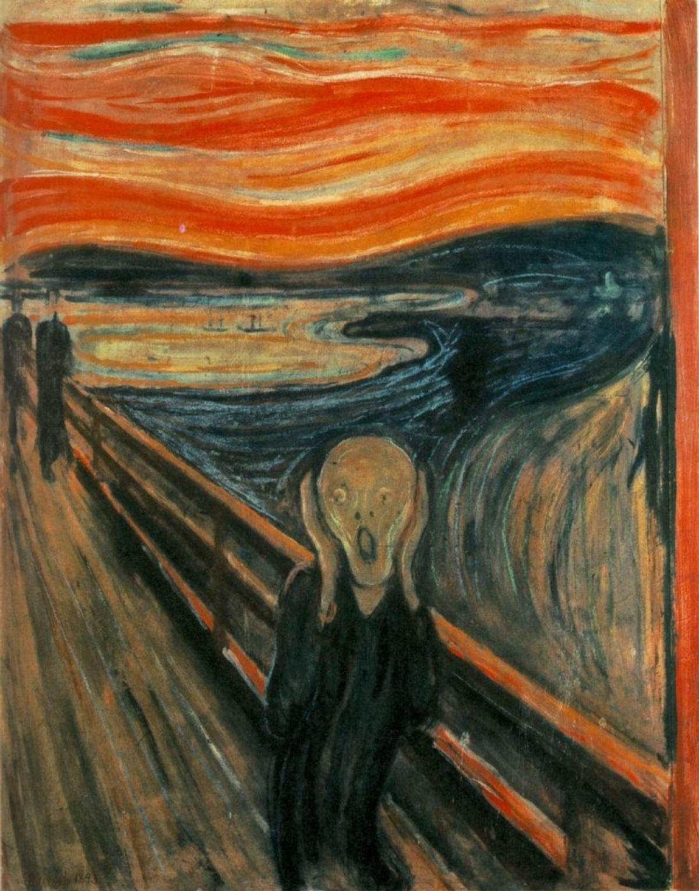
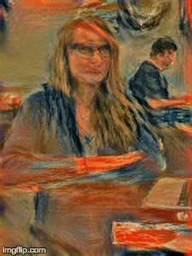

Slide 10
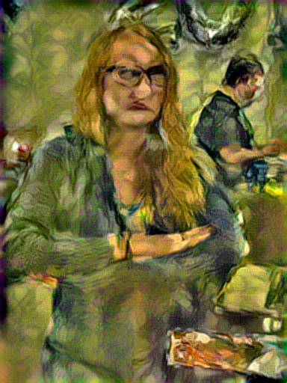
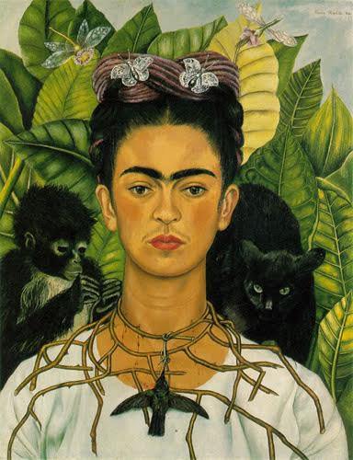
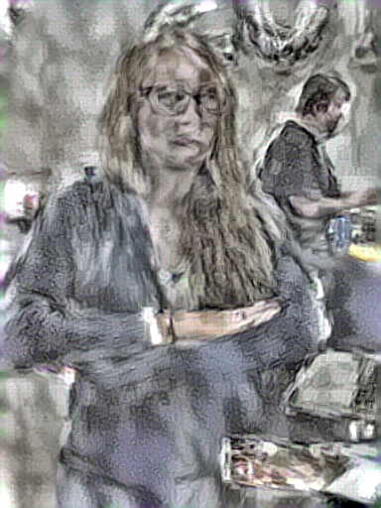
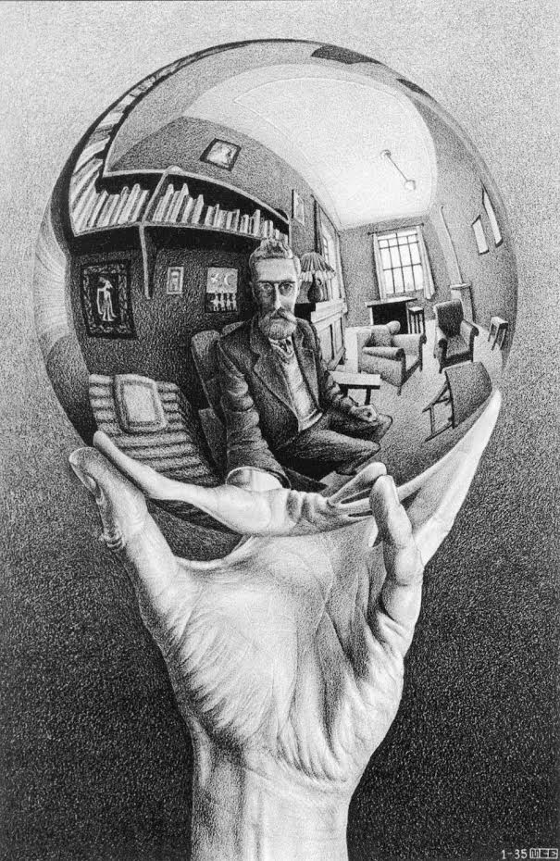
Some more examples

Slide 11
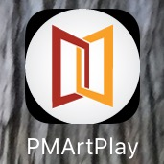
iOS app icon

Slide 12
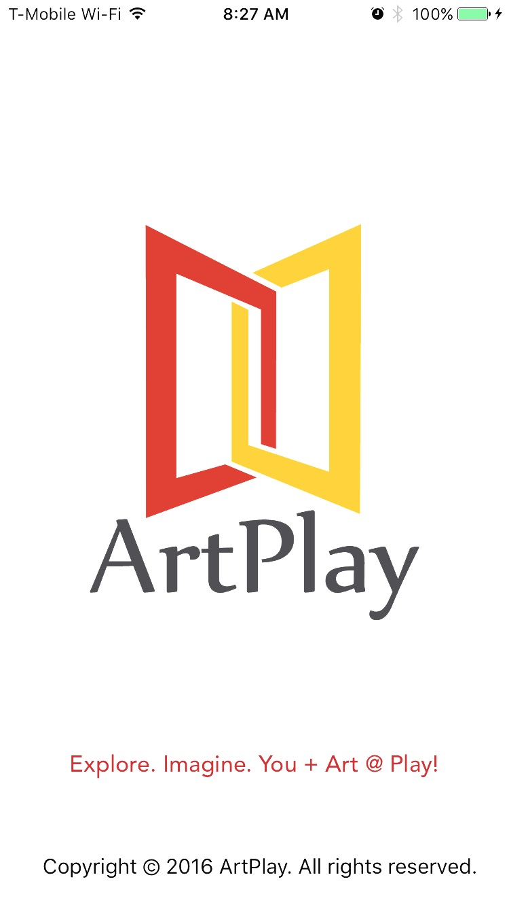

Slide 13
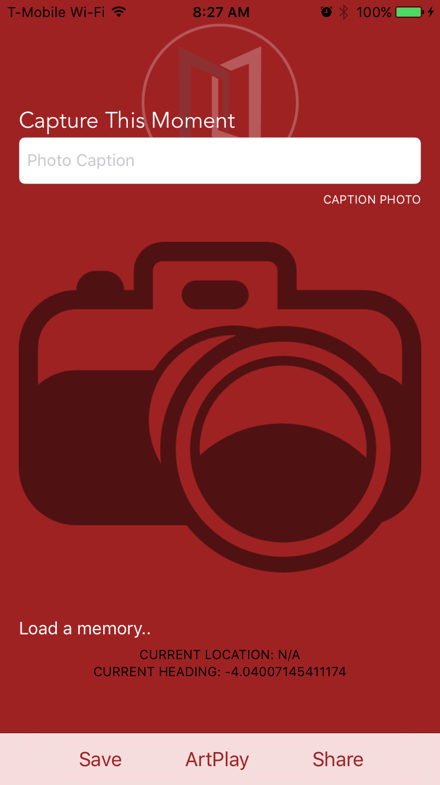

Slide 14
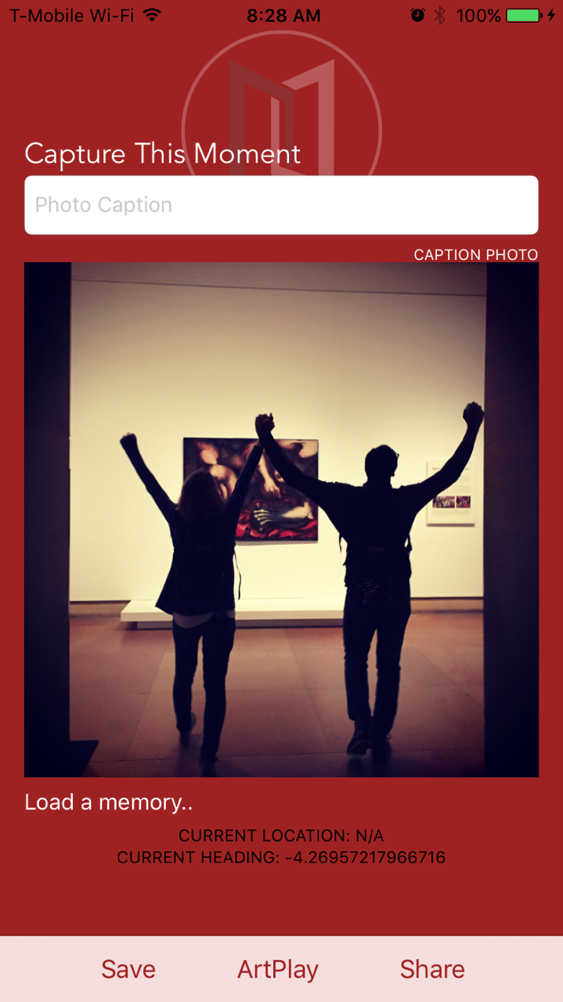

Slide 15
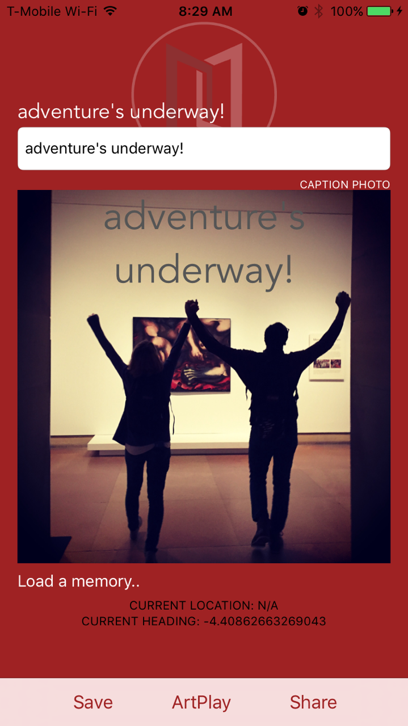

Slide 16
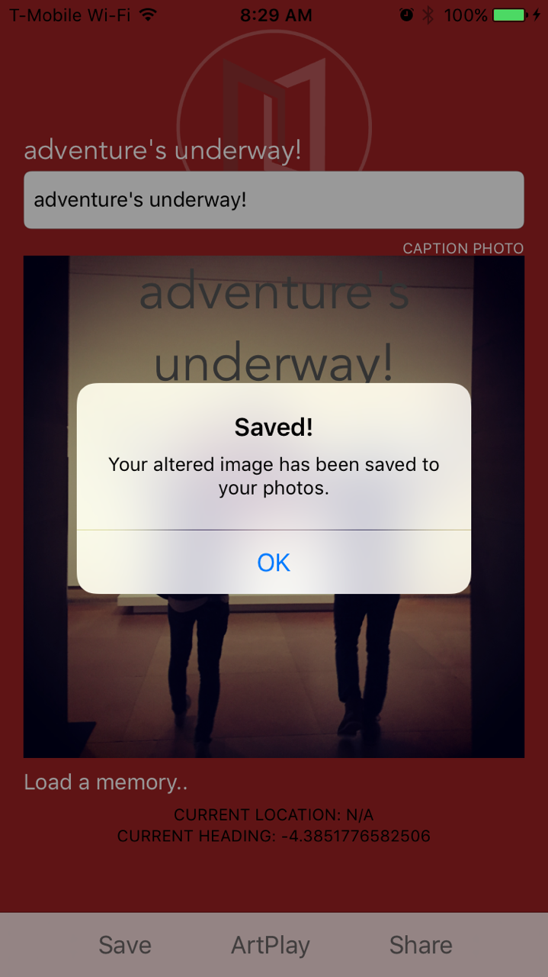

Slide 17
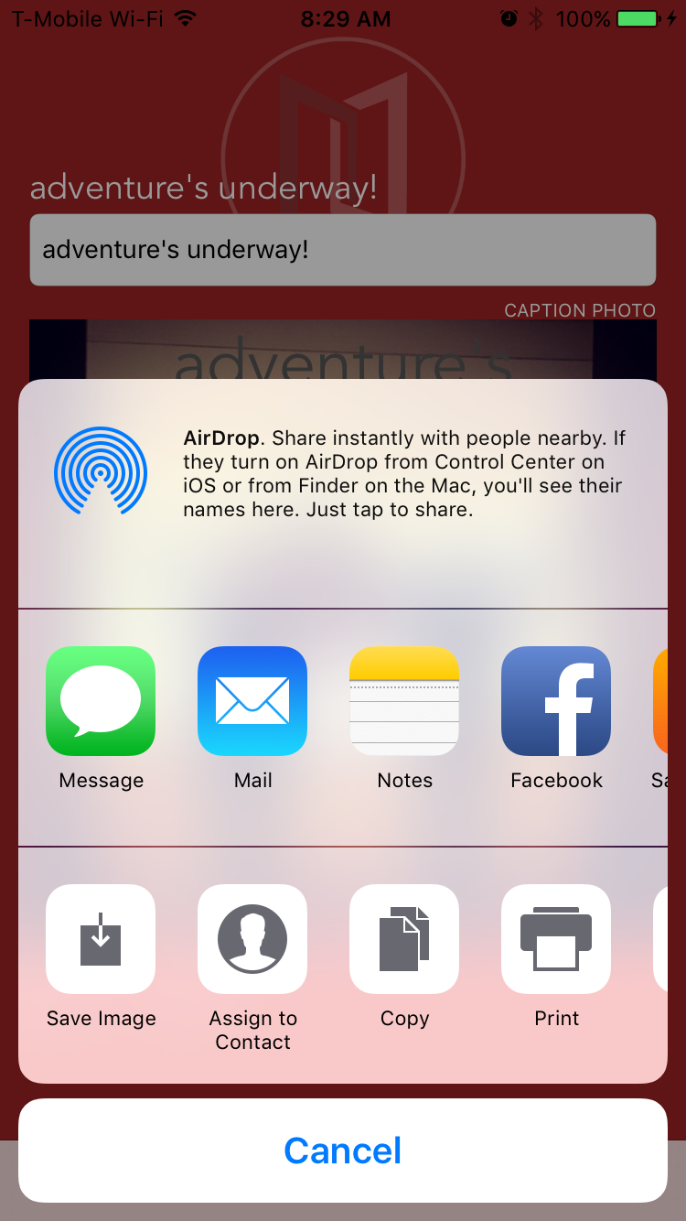

Slide 18
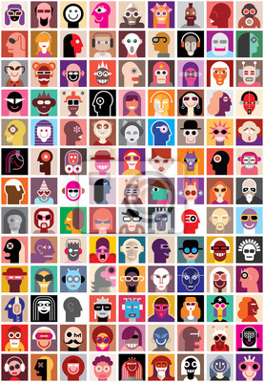
Next Steps
One collection wall to create an interactive mural
Mural/Display of all of the pictures of the day
YOU are part of the Museum

